Slide 1
20411D
Administering Windows
Server® 2012
Notes:
This introduction module provides students with an overview of the course content materials and logistics for Course 20411D, Administering Windows Server® 2012.

Slide 2

Welcome!
Thank you for joining us today.
We’ve worked together with Microsoft Learning Partners and Microsoft IT Academies to bring you a world-class learning experience, including:
Microsoft Certified Trainers + Instructors. Your instructor is a premier technical and instructional expert who meets ongoing certification requirements.
Customer Satisfaction Guarantee. Our Partners offer a satisfaction guarantee and we hold them accountable for it. At the end of class, please complete an evaluation of
today’s experience. We value your feedback!
Certification Benefits. After training, consider pursuing a Microsoft Certification to help distinguish your technical expertise and experience. Ask your instructor about available exam promotions and discounts.
We wish you a great learning experience and ongoing career success!

Slide 3
Hello
Instructor: <Instructor Name>
<Title or other credentials, e.g., Microsoft Certified Trainer>
<Affiliation/Company>
<A few words about my technical and professional experience>
Notes:
Welcome students to the course and introduce yourself. Provide a brief overview of your background to establish credibility.

Slide 4
Student Introductions
Name
Company affiliation
Title/function
Job responsibility
Network administration, help desk, system administration experience
Windows Server 2012 R2 experience
Your expectations for the course
Notes:
Ask students to introduce themselves and provide their backgrounds, product experience, and expectations for the course.
Record student expectations on a whiteboard or flip chart that you can reference during class.

Slide 5
Facilities
Class hours
Building hours
Parking
Restrooms
Meals
Phones
Messages
Smoking
Internet access
Recycling
Emergency procedures
Notes:
Explain the:
Class hours
Extended building hours for labs
Parking
Restroom location
Meals
Phones
Message posting
Where smoking is or is not allowed
Let students know if your facility has Internet access that is available for them to use during class breaks.
Make sure that the students are aware of the recycling program if one is available.
Finally, inform students about any emergency procedures (for example, emergency exits) and plans in the event of fire or other such emergency.

Slide 6
About This Course – Audience
Candidates who attend this course typically are:
Windows Server administrators who are relatively new to Windows Server administration and related technologies
IT professionals who are experienced in non-Microsoft technologies
IT professionals who have some knowledge and experience working with Windows operating systems
IT professionals who want to take the relevant exams or certifications
Notes:
Describe the audience for this course. This is an opportunity for you to identify students who may not have the appropriate background or experience to attend this course.

Slide 7
About This Course - Prerequisites
Before attending this course, students must have:
An understanding of networking fundamentals
An understanding of basic Active Directory concepts
An awareness and understanding of security best practices
Basic knowledge of server hardware
Experience working with, and configuring, Windows client operating systems, such as Windows 7 or Windows 8
Notes:
Describe the course prerequisites.

Slide 8
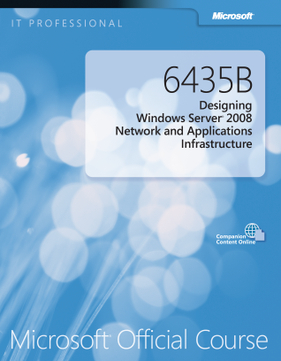

Your Course Materials (Optional)
Designed to optimize your classroom learning experience and support you back on the job.
Microsoft Official Course Handbook
Printed Courseware book
Organized by modules
Includes Labs and Lab Answer Keys
Module Reviews and Takeaways—great for on-the-job reference
Digital Companion Content
Supplemental content and helpful links
Download at: http://www.microsoft.com/learning/companionmoc
Notes:
<<< Use this slide for printed courseware and the next slide for digital courseware. >>>
<<< Delete the slide that you are not using.>>>
Introduce the students to their course materials.
Explain how you intend for students to use the Course Handbook in the class and the Digital Companion Content outside the class:
Explain that during the lecture, the students can refer to the Course Handbook, because it contains all of the critical technical information that they need in a crisp, tightly-focused format, which is just right for effective in-class learning experience.
Mention that the Digital Companion Content on the http://www.microsoft.com/learning/companionmoc website supplements the Course Handbook, and provides an opportunity for extended self-oriented learning beyond the classroom.

Slide 9
Your Course Materials (Optional)
Microsoft Official Course Handbook
Accessed online using the Arvato Skillpipe reader at http://skillpipe.courseware-marketplace.com/reader
Registration/Login and redeem your digital courseware
Add notes, add comments, and highlight content just as you would with printed materials
Organized by modules
Includes Labs and Lab Answer Keys
Module Reviews and Takeaways—great for on-the-job reference
Digital Companion Content
Supplemental content and helpful links
Download at: http://www.microsoft.com/learning/companionmoc
Notes:
<<Use this slide for digital courseware and the previous slide for printed courseware.>>
<<< Delete the slide that you are not using.>>>
Introduce the students to their course materials.
You should take the opportunity to make sure that all students can log in and access their content, and also demonstrate some of the features and functionality.
You can also mention that the courseware is updated over time. Their content will also be updated so they always have the latest, most technically up-to-date content, and they will not lose any comments, notes, or highlights they have made.

Slide 10
Course Outline
Module 1: Configuring and Troubleshooting Domain Name System
Module 2: Maintaining Active Directory Domain Services
Module 3: Managing User and Service Accounts
Module 4: Implementing a Group Policy Infrastructure
Module 5: Managing User Desktops with Group Policy
Module 6: Installing, Configuring, and Troubleshooting the Network Policy Server Role
Module 7: Implementing Network Access Protection
Module 8: Implementing Remote Access

Slide 11
Course Outline (continued)
Module 9: Optimizing File Services
Module 10: Configuring Encryption and Advanced Auditing
Module 11: Deploying and Maintaining Server Images
Module 12: Implementing Update Management
Module 13: Monitoring Windows Server 2012

Slide 12
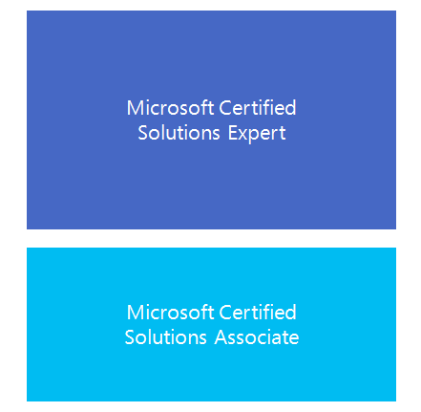

Microsoft Certification Program
Get trained. Get certified.
Get ahead.
Microsoft Certifications demonstrate you have the skills to design, deploy, and optimize the latest technology solutions.
Ask your Microsoft Learning Partner how you can prepare for certification.
Also see:
http://www.microsoft.com/learning/
certification

Slide 13
Windows Certification Paths
MCSA Windows Server 2012
MCSE Server Infrastructure
Exam 70-410
(20410)
Installing and Configuring Windows Server 2012
Exam 70-411
(20411)
Administering Windows Server 2012
Exam 70-412
(20412)
Configuring Advanced Windows Server 2012 Services
Exam 70-413
(20413)
Designing and Implementing a Server Infrastructure
Exam 70-414
(20414)
Implementing an Advanced Server Infrastructure
MCSE Desktop Infrastructure
Exam 70-417
(20417)
Upgrading Your Skills to MCSA Windows Server 2012
Exam 70-415
(20415)
Implementing a Desktop Infrastructure
Exam 70-416
(20416)
Implementing Desktop Application Environments
OR
MCSA Windows 8
Exam 70-687
(20687)
Configuring Windows 8.1
Exam 70-688
(20688)
Supporting Windows 8.1
Exam 70-689
(20689)
Upgrading Your Skills to MCSA Windows 8
OR
Notes:
Inform students about the Microsoft Certified Professional (MCP) program, any certification exams that are related to this course, and the various certification options.
Explain the Microsoft Learning program, and present the list of additional recommended courses.
For information about curriculum paths, refer students to the Microsoft Learning webpage at http://www.microsoft.com/learning/.

Slide 14

Preparing for the Labs
Your lab activities will be centered around a fictitious company that we will call A. Datum Corporation
By working through the labs, you will learn how to administer Windows Server 2012 R2.
To complete the labs, you will work in a virtual machine environment.
Notes:
Tell students whether the course labs will be run as on‑premises (local) labs, or as Microsoft Labs Online (MLO) hosted labs.
On‑premises labs are run on the local host machines in Hyper‑V.
MLO labs are accessed on the local host machines via a web browser, such as the virtual machines that are running on a hosted platform and accessed via a browser.

Slide 15
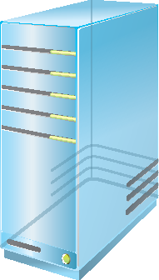
Virtual Machine Environment
Virtual machine name: | Use as:
20411D-LON-DC1 | A Windows Server 2012 R2 Domain Controller in the Adatum.com domain
20411D-LON-SVR1 | A Windows Server 2012 R2 member server in Adatum.com domain
20411D-LON-SVR3 | A blank virtual machine for use in labs
20411D-LON-SVR4 | A Windows Server 2012 R2 member server in Adatum.com domain
20411D-LON-RTR | A router that is used for network activities that require a separate subnet. Also running Windows Server 2012 R2
20411D-LON-CL1 | A Windows 8.1 client joined to Adatum.com domain.
20411D-LON-CL2 | A Windows 8.1 client joined to Adatum.com domain.
20411D-LON-CL3 | A Windows 7 client joined to Adatum.com domain.
20411D-INET1 | A Windows Server 2012 R2 server simulating an Internet Web and DNS server
Notes:
These are the virtual machines that this course will use:
20411D‑LON‑DC1
20411D‑LON‑SVR1
20411D‑LON‑SVR3
20411D‑LON‑SVR4
20411D‑LON‑RTR
20411D‑LON‑CL1
20411D‑LON‑CL2
20411D‑LON‑CL3
20411D‑INET1

Slide 16
Demonstration: Using Microsoft Labs Online
In this demonstration, you will learn how to:
Access the MLO lab environment
Switch between virtual machines
Carefully read the online Lab Notes because some procedures related to on-premises versus online labs may be different and have slightly different steps. Any differences will be called out in the Lab Notes
Notes:
<<< Use this slide for MLO, and the next slide for on-premises (local) labs. >>>
<<< Delete the slide that you are not using.>>>

Slide 17
Demonstration: Using Hyper-V Manager
In this demonstration, you will learn how to:
Open Hyper‑V Manager
Navigate the various sections/panes within Hyper‑V Manager:
Virtual machines, snapshots, and actions: server-specific and virtual machines-specific
Identify the virtual machines used in the labs for this course
Take a snapshot and apply a snapshot
Connect to a virtual machine
Start and sign in to a virtual machine
Switch between full screen and window modes
Revert to the previous snapshot
Shut down a virtual machine
When to use shut down or turn off
Close Hyper-V Manager
Notes:
<<< Use this slide for on-premises (local) labs and the previous slide for MLO.>>>
<<< Delete the slide that you are not using.>>>

Slide 18
Demonstration: Navigation in Windows Server 2012
In this demonstration, you will learn how to:
Configure Hyper-V to use Windows key combinations in the virtual machine
Sign in and sign out
Access applications
Access Control Panel
Use shortcut keys

